Slide 1


#ScottishSummit2021
Allan De Castro
Introduction to Power Apps Component Framework
Coatbridge 11:00am-11:45am
Notes:
Hello and welcome everyone to Scottish Summit 2021 and thank you all for attending this session on the Power Apps Component Framework! Before we begin, I hope you are all doing well with this global pandemic situation! Keep your head high and don't give up, things can only get better.

Slide 2

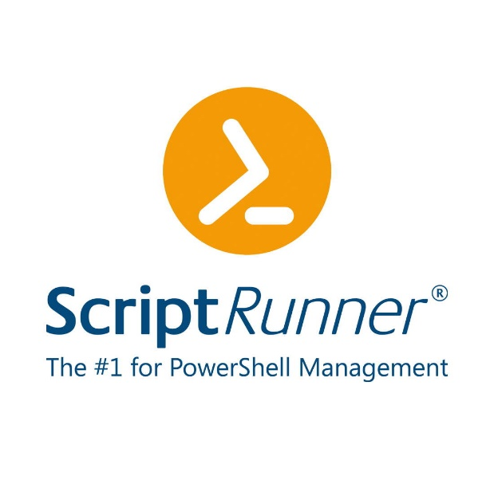



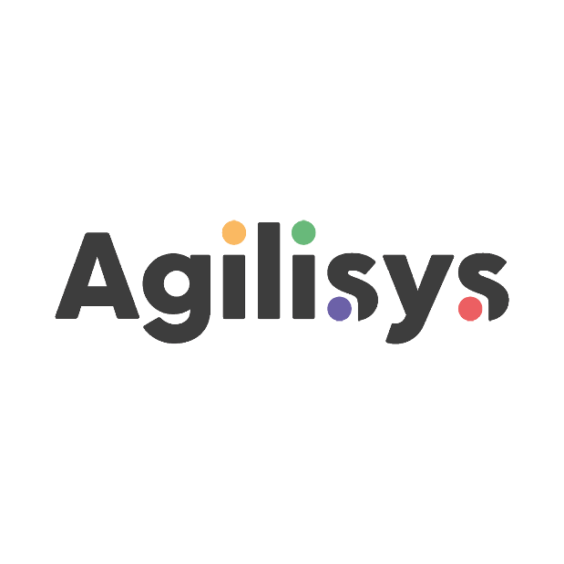

Our Sponsors
Notes:
Before I start and introduce myself, I would like to thank the organization team and all the sponsors that you can see on this slide because it is thanks to them that this type of event is possible!

Slide 3

Allan
De Castro
Avanade France
Power Platform Technical Consultant
@decastroallan
blog.allandecastro.com
Notes:
My name is Allan De Castro, I am a technical consultant working for Avanade France! I am originally from the D365 Customer Engagement world and I'm becoming more and more involved in the community so don't hesitate to contact me either on Twitter or on my blog!

Slide 4
Activities & timeline
What is the Power Apps Component Framework?
History, Definition, Availability, Types of components
01
Live demonstration
02
Getting started with PCF (a.k.a. Goodbye Web Resources)
Community Stuff, Deployment and configuration
Technologies, Framework, First steps, Tools needed, Power Apps CLI, XrmToolBox Plugin, Architecture, Lifecycle
03
QnA
04
Resources Link, Ask me everything, Any PCF Ideas ?
Notes:
So during this PCF session, we will try to follow the following agenda, so first a presentation of the Framework to understand what it is and then the most fun: a demo, finally a part to understand how to get started with this Framework and start playing with it and of course I'll answer your questions.

Slide 5

What is the Power Apps Component Framework?
Notes:
So to get started, the question is quite simple: What is the Power Apps component Framework?

Slide 6
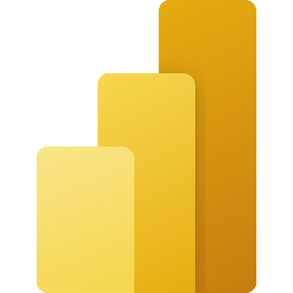



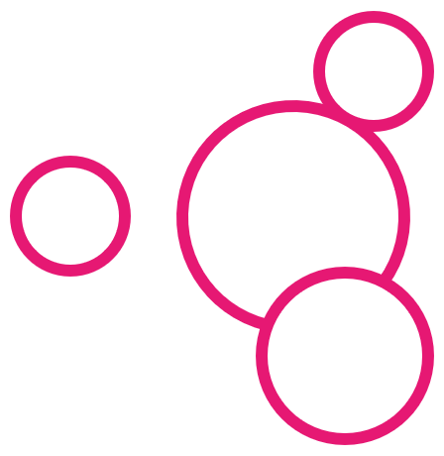

What is Power Apps?
Power BI
Business analytics
Power Apps
Application development
Power Automate
Workflow automation
Power Virtual Agents
Intelligent virtual agents
Power Apps Component Framework
Data connectors
AI Builder
Dataverse
Notes:
If we pay attention to the complete Power Paltform stack that you all need to know, we can find the 4 main Power services: BI, Apps, Automate, Virtual Agent.
If we place the PCF here, PCF is the component that allows us to extend this platform, to develop custom components for the UI for PowerApps (Model Driven App and Canvas App)! How many we have already heard about PCF here? How many we have already done here?

Slide 7
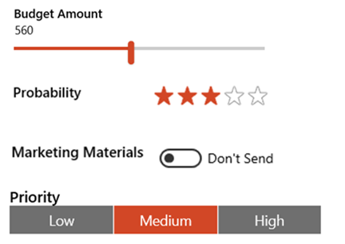
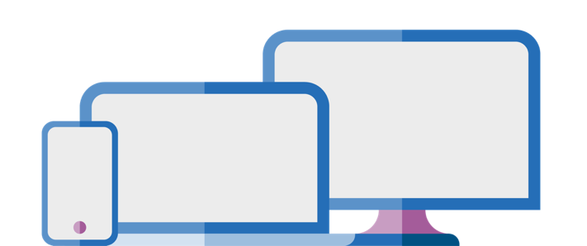
History
First Components introduced in 2016:
Set of optimized mobile controls
Unified Interface -> Components for all
At that time, we were talking about Custom Control using an exclusive Microsoft framework
Power Platform, renamed into Power Apps Component Framework
Custom Control → PCF→ Power Apps Component Framework
Notes:
The first component concepts arrived in 2016 with optimized controls especially for mobile devices. After the availability and realease of the Unified Interface, the first Customs Controls appeared for Dynamics 365, which can be visible on mobile, tablet and more traditionally on the web client.
Example: the editable grid that was quite expected -> At this stage we talked about Custom Control which uses a proprietary Microsoft framework, so it's something really obscure.
After the rebranding of the Power Platform, they just renamed it to Power Apps Component and finally they announced the preview of the Power Apps component Framework in April 2019.

Slide 8
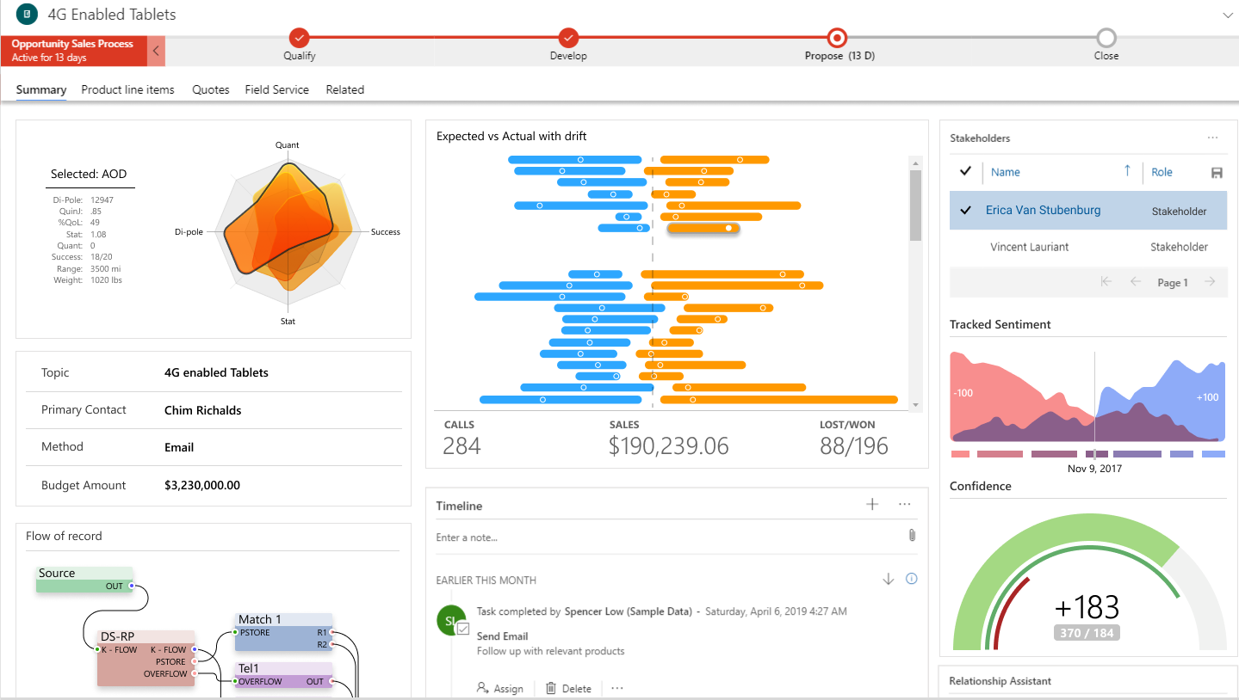
Definition
Model Driven App, Canvas Apps & Portal
1st and 3rd party developers
Professionally developed controls with well defined contracts, lifecycle and interaction model
Improves performance
Create your own user experience
Modern Tooling (CLI)
Notes:
When ms started building the App for Dyn 356 and started re-imagining them, they needed to find something to build components that would work on different media.
They have therefore invested to allow their engineer to manage the different implementations between Browser, OS (Ios Android etc...) ...
They created a framework that makes it easier for their developers (1st Party developers) to build components that can be used by different applications and to be able to be part of the ALM (Application Life cycle Management) of Apps.
As soon as they were able to build this framewokr MS had already the vocation to expose it to the 3th party developers (= community).
So we can now create our own custom component!
Many things are already designed with this Framework, so it's something we already use without even knowing it.
We will be able to replace the user experience provided by the OOB product and insert our own in terms of visualization or even if we want to make embedded components with a certain logic by making external calls etc...
The advantage when we create a custom component is that it is an integral part of the application life cycle. It is this one that will feed the component with data and we will be able to add parameters etc. to make it dynamic and adaptable to any other context. The important thing is that all components are configurable (= specific to certain entities).

Slide 9
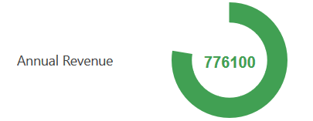
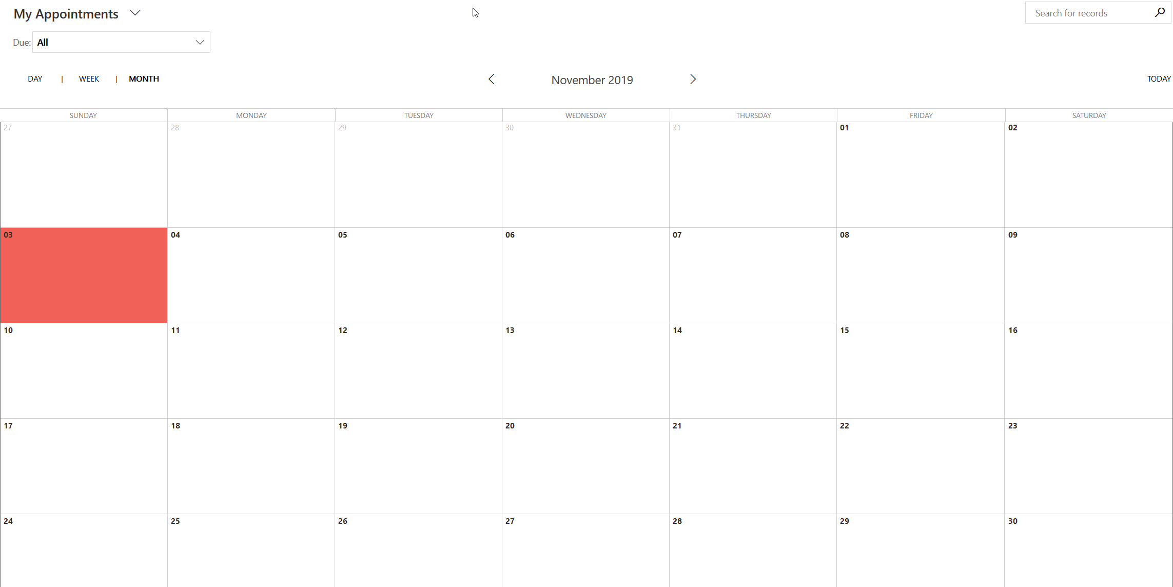
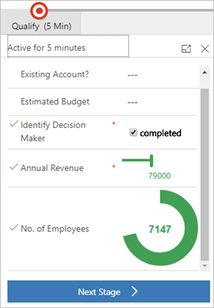
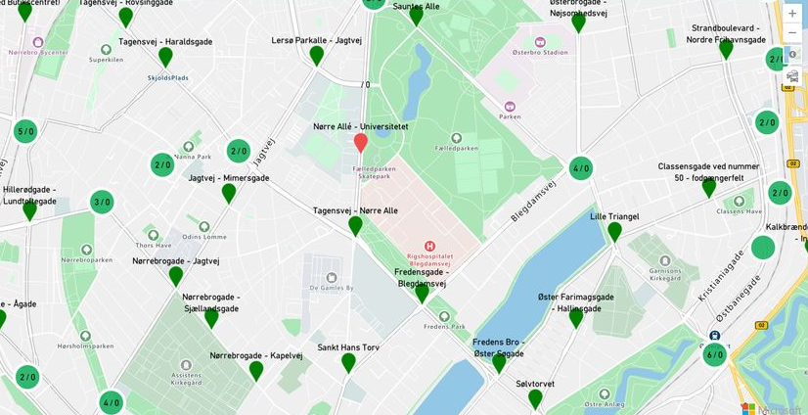
Out-of-the-box component
Field on the form
DataSet (Entity Grid/SubGrid)
Business Process step
Display/Use external content (LinkedIn, API, Azure Maps…)
Notes:
You already know some of them that exist as standard, it can be on fields, dataset like a calendar view for appointments, the schedulebaord field service, we can also add them in data steps but also use them to retrieve data from external services (LinkedIn Sale Navigator uses this framework).

Slide 10
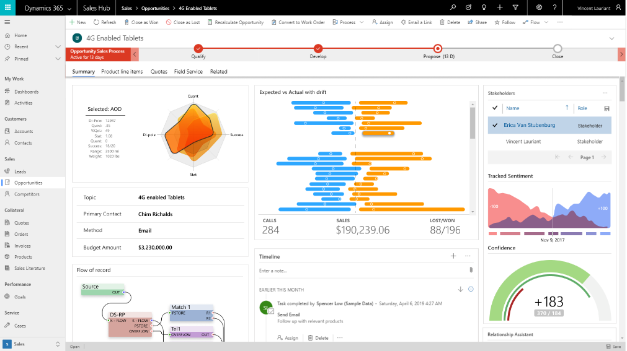
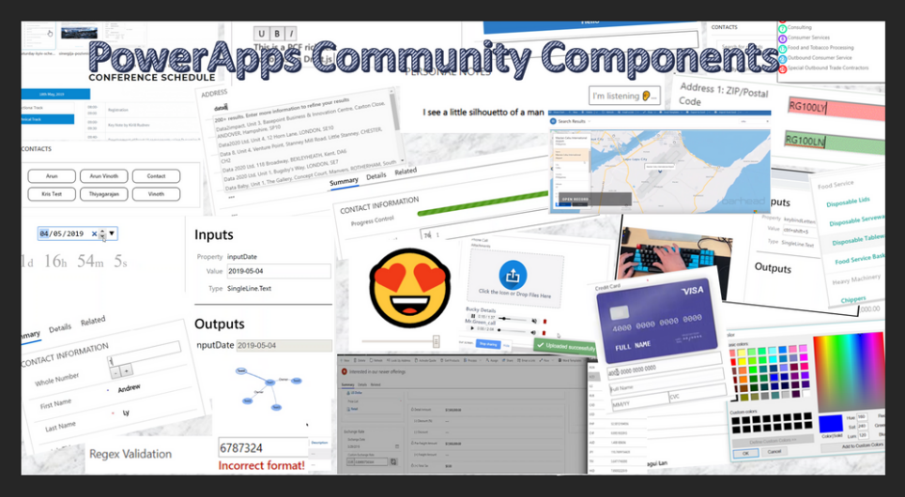
Availability
Public Preview, April 23, 2019
The PowerApps component framework and the PowerApps CLI is now available for public preview
General Availability, October 1, 2019
Announcing the general availability of the PowerApps component framework for model-driven applications and PowerApps CLI
Notes:
For your information, this is a feature that has been released quite recently, we are talking about April for the public preview and October for the GA. We’re only talking about Model Drinve App here but . For the canvas apps it was like…: Public Preview Nov 2019 and GA Early 2020.

Slide 11
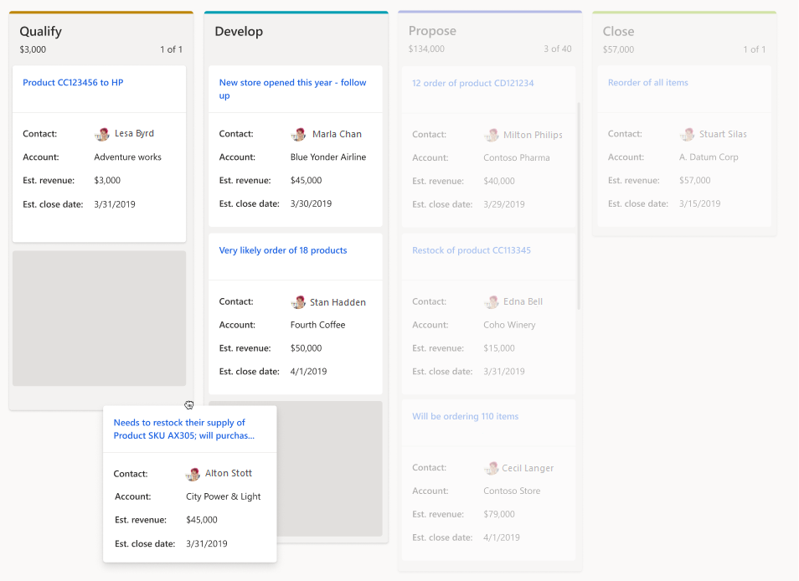
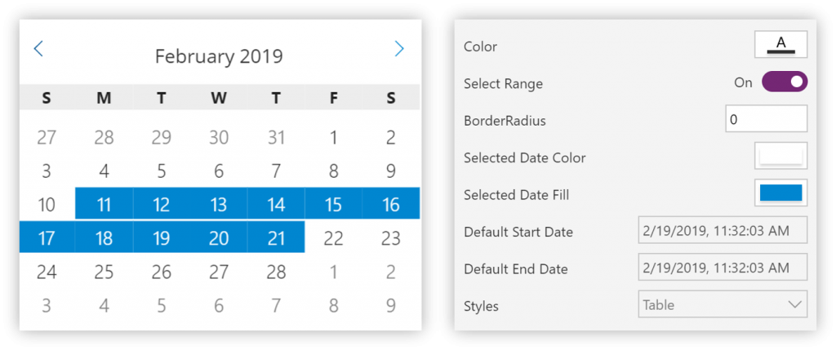
Two Types of Components
Custom Canvas Compositions : Low-code composition using expressions and connectors (Canvas App).
Custom Pro Components : Create more sophisticated component using code (Model Driven App, Canvas App & Portal)
Notes:
When we talk about component, we must make the difference between the Canvas App type components (with the use of basic expressions) and the components built using code that will allow us to go much further.

Slide 12
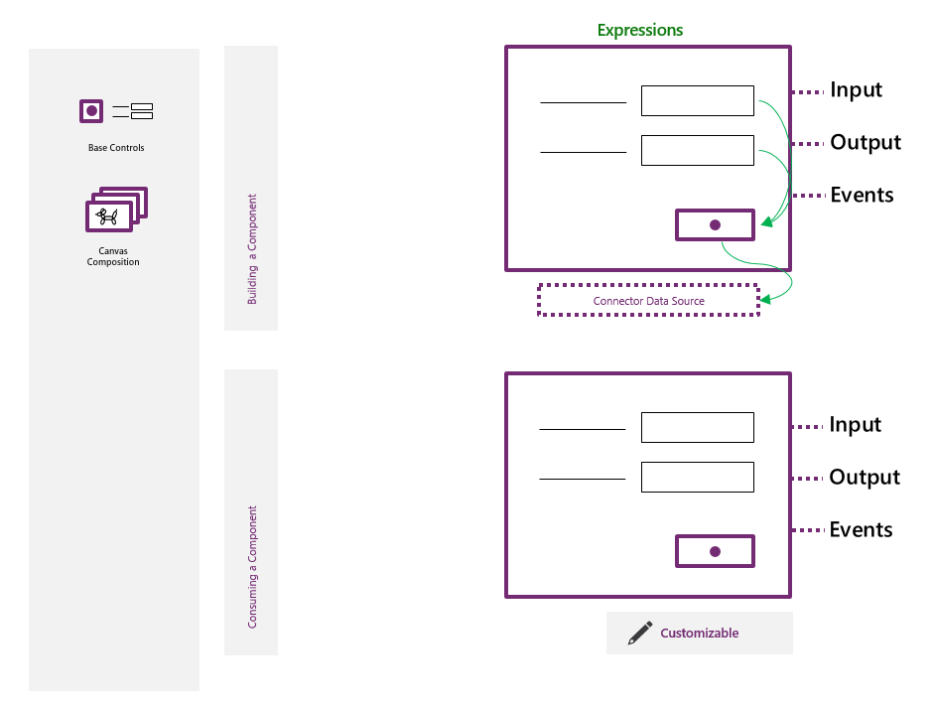
Custom Canvas Compositions
Allows you to connect the basic commands between base control and the connectors using expressions.
Use of OOB controls available, enriched with expressions and connected data (using connector) to produce reusable components.
Input and output properties to interact with the component by passing data (can be used to change the visual aspect).
Business App Summit 2019: Microsoft PowerApps: Building and Extending Application
Notes:
For the "Canvas" type components, we can create components by connecting the basic controls to each other using the low code expressions that I think we all know very well! We will still be able to indicate input and output properties.
This type of component can be modified by citizen developers.

Slide 13
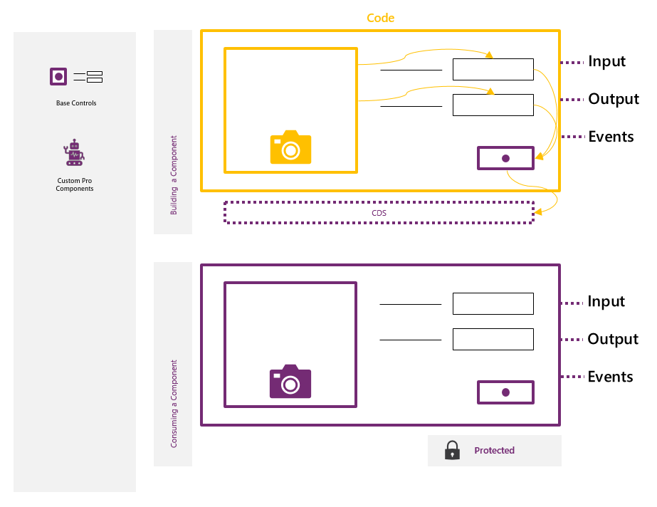
Custom Pro (Dev) Compositions
Using code to connect base controls. Custom Pro (Dev) Components use input and output properties and can connect natively to Dataverse. Custom Pro (Dev) Components are consumed as black box components to Makers, and can’t be customized through maker experiences, except for developer designated properties.
Business App Summit 2019: Microsoft PowerApps: Building and Extending Applications
Notes:
For the pro components, using the Framework, we will also connect with basic controls but here it will be a question of using code development (typescript in particular) to implement the logic and thus to have a panel of possibility much broader and that also applies to the UI side! We will be able to use in a native way the Web Api of Dataverse and for this kind of component they will be consumed like a black box in the sense that only a developer will be able to look inside and modify it, only the parameters will be able to be changed by the customizers.

Slide 14





Two Types of Components
An extensibility Framework for professional developer to create custom component and user experiences to be leveraged by citizen developers:
Conception
Packaging
Installation
Configuration
Client Rendering
Using full HTML, JavaScript, React.. to create custom UI.
Access to an extensive API Surface.
PowerApps CLI (Managed & UnManaged).
Rich ecosystem of re-usable, accessible, and performant UI component.
Import into Dataverse Environment
Configurable by Makers
Both App + Portal
Adapts according to the configuration
Improves performance
Notes:
To sum up, we have here a framework for a developer audience that really focuses on the user experience, uses standard web technologies, so no proprietary language, e.g. take sample code to design a PCF
You have direct access to the context of the form for a Model Driven App etc. and you can easily interact with the WebAPi.
It can be packaged as a Managed and/or Managed solution thanks to the tools. It can be made dynamic and configurable by the people who install it (this is where the component/asset principle makes sense).
We don't have to worry about the support because the control adapts itself according to the configuration and the device.
When loading the form, we won't have to retrieve the information from our component because the component is really part of the App so it will be more powerful and faster than an iframe or webresource.

Slide 15
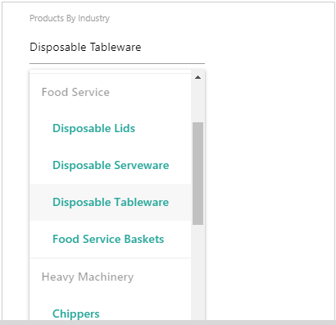
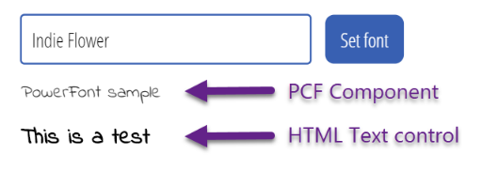
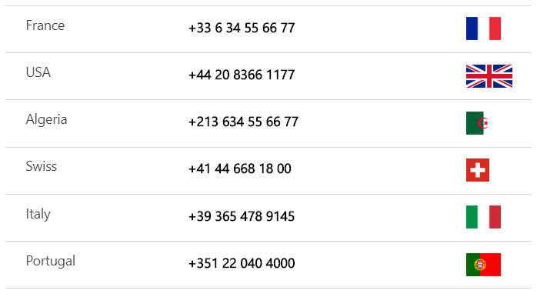
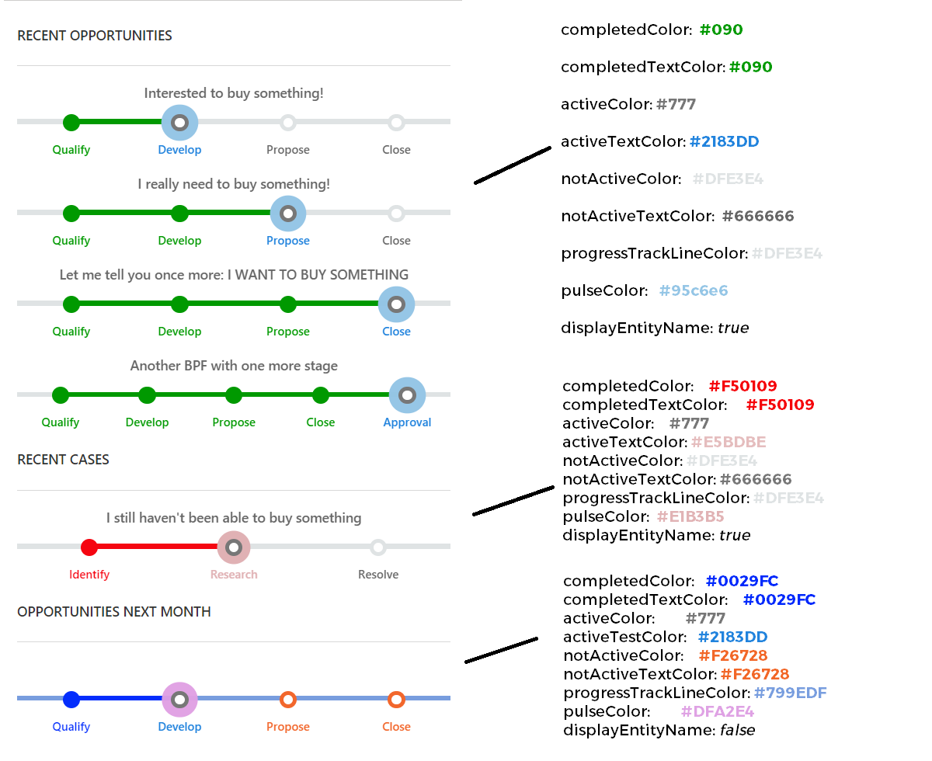
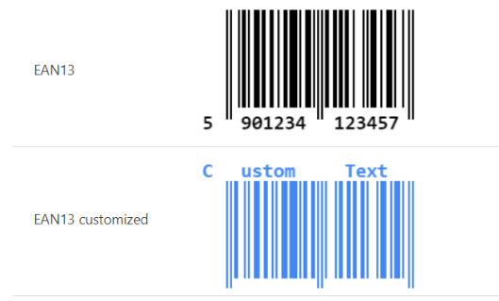
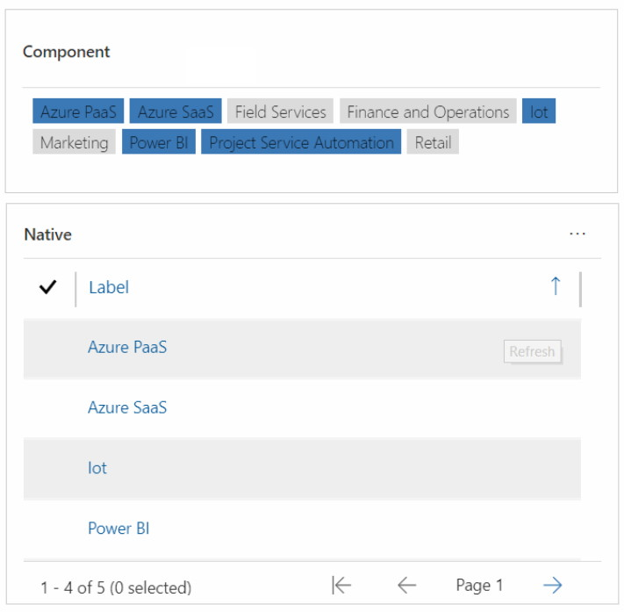
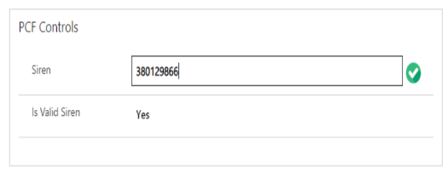
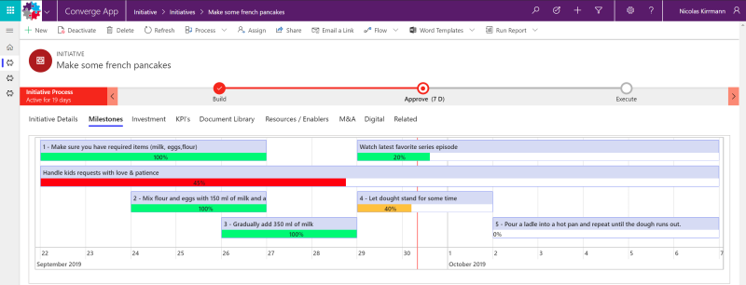
Examples
Notes:
Here are some examples of components created by the community:
Here we have the possibility to have a field of type Choice with categories of options as you can see in gray
A component that allows us to use a particular font from google font
Here we will display the value of a field as a barcode.
A SIREN/SIRET number validation component
A component allowing the display and formatting of a telephone number with the country code.
Adding a set of tag to a record
A visualization of a list of record, for example tasks, as a timeline with a progression bar like a gant chart.
A component that allows you to view stages or categories of business process flow used on a list of records.

Slide 16
Live Demonstration
Community Stuff
Deployment and configuration
PhoneNumberByCountry
VATNumberValidator
BusinessProcessFlowViewer

Slide 17

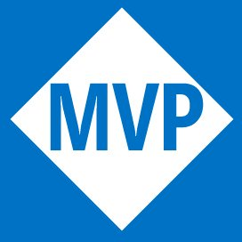
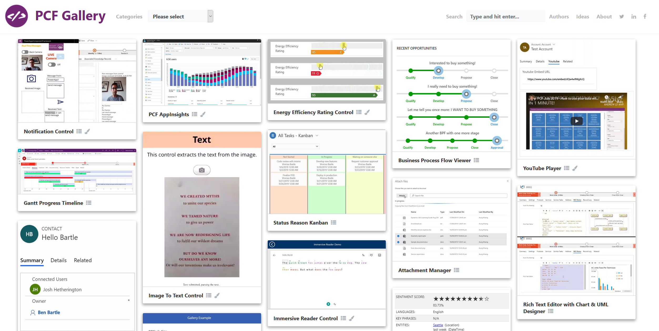
Examples
PCF Gallery by Guido Preite @crmanswers
Notes:
Before starting the demo, I just wanted to tell you about the pCF gallery site where you can find a lot of different PCFs

Slide 18
DEMO

Slide 19
Examples
Business Process Flow Viewer
Displays BPFs with all process stages OR categories of entities from a grid/views.
Benefits:
Improves information's visualization
Fully configurable
Supports any entities (OOB, custom...)
Supports any BPFs (OOB, custom…)
FREE! https://github.com/allandecastro/BusinessProcessFlowViewer
Notes:
One of the components we've just seen, this "Business process flow viewer" that I've created, allows us to visualise the progress of a recording in relation to the business process flow used and we have a certain number of parameters that we can modify to manage different types of BPF, manage colours but also certain feature such as whether to display the name of the recording, decide to display by stages or categories, etc....
Of course it's totally free as you can see !

Slide 20
Getting started with PCF (a.k.a. Goodbye Web Resources)
Technologies
Approach
Tools & Architecture
Notes:
Ok great, now the goal is to go deeper into this Power Apps Component Framework that we can totally consider as the new generation of web resources!

Slide 21









Technologies
Many advanced technologies to take these components to the next level!
Notes:
We will be able to use many of the web technologies that you are certainly familiar with, allowing us to create a very interesting component! TypeScript which is the mandatory language for building PCF NPM: the official package manager of node js
node js: is a JavaScript runtime environment
React: JavaScript engine, a free JavaScript library developed by Facebook since 2013.

Slide 22
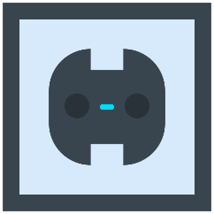
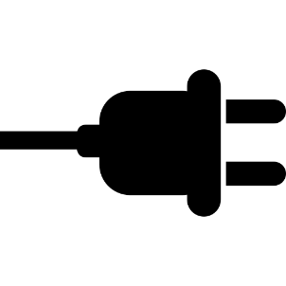

Framework Concept
Framework Interface aka Socket
Interface API SDK provides methods for control lifecycle, data/metadata access and more.
Component implement the framework interface and functional logic.
Notes:
Here is a simple explanation of how the framework works, we can consider it as the relationship between an electrical device that is going to be powered by an electrical outlet When we plug the component into the outlet we must ensure to implement a specific architecture, the Framework itself, and so we can have access to a lot of things like metadata field etc..
It's a completely different approach compared to the web resources or in this case we go to retrieve the data/information while here it's the application itself that feeds the component.

Slide 23

We spend a lot of time designing the bridge, but not enough time thinking about the people who are crossing it.
Dr. Prabhjot Singh, Columbia University
Notes:
Before starting to build a component you should not hesitate to ask yourself some questions, I like this picture and this quote that could apply to many situations.

Slide 24


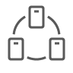



Thinking before acting
What types of data will it use?
Will it be used on a field or on a dataset?
What features must be implemented to take full advantage of this component?
What problem do I want to answer ?
What is the added value of building a component?
External services ?
What parameters do I want to keep free to modify?
Notes:
First of all, it is essential to ask a few questions about the usefulness of this component, the types of data it will rely on, the services it will use, and above all the design!
I really support this last point because the very purpose of an asset in general, in our case a FCP, must not only meet a technical need but also implement ergonomics that will improve the visualization of information, navigation and therefore the appropriation of the application.
For my part, I always try to start from an existing need whether it is an idea found on a forum, a professional need or simply a personal desire to display information in a much sexier format . !

Slide 25



Equip yourself!
Install Npm or Node.js, one will come with the other in any case!
Make sure you have the .NET Framework 4.6.2 Developer Pack.
Install Microsoft PowerApps CLI.
Note: XrmToolBox plugin exists PCF Custom Control Builder.
Notes:
Because a (good) gardener never starts work without his tools, you must do the same! In our case, these tools are quite simple to have! Note that a XrmToolBox plugin can help you to implement your component: https://github.com/Danz-maveRICK/PCF-CustomControlBuilderget the following different components:

Slide 26
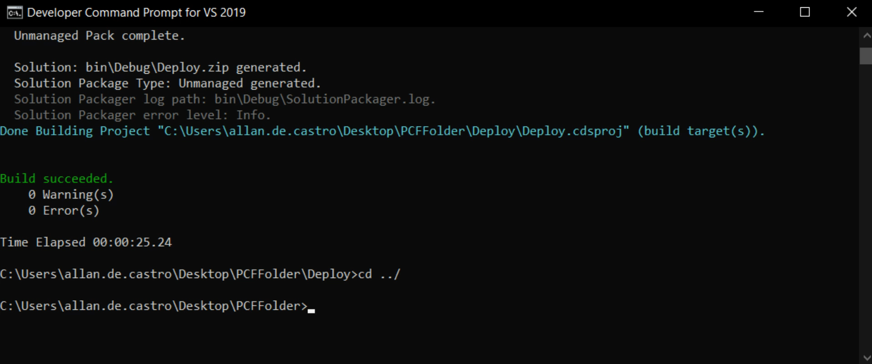
Power Apps CLI
A unique tool that initially focuses on developing custom controls, plugins and web resources.
Command Line Interface which enables developers to be more efficient in their PCF development !
Control templates (field and dataset)
Build in validations to catch issues prior to deployment
Can be used as part of your automated processes

Slide 27
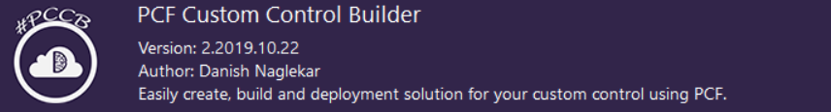
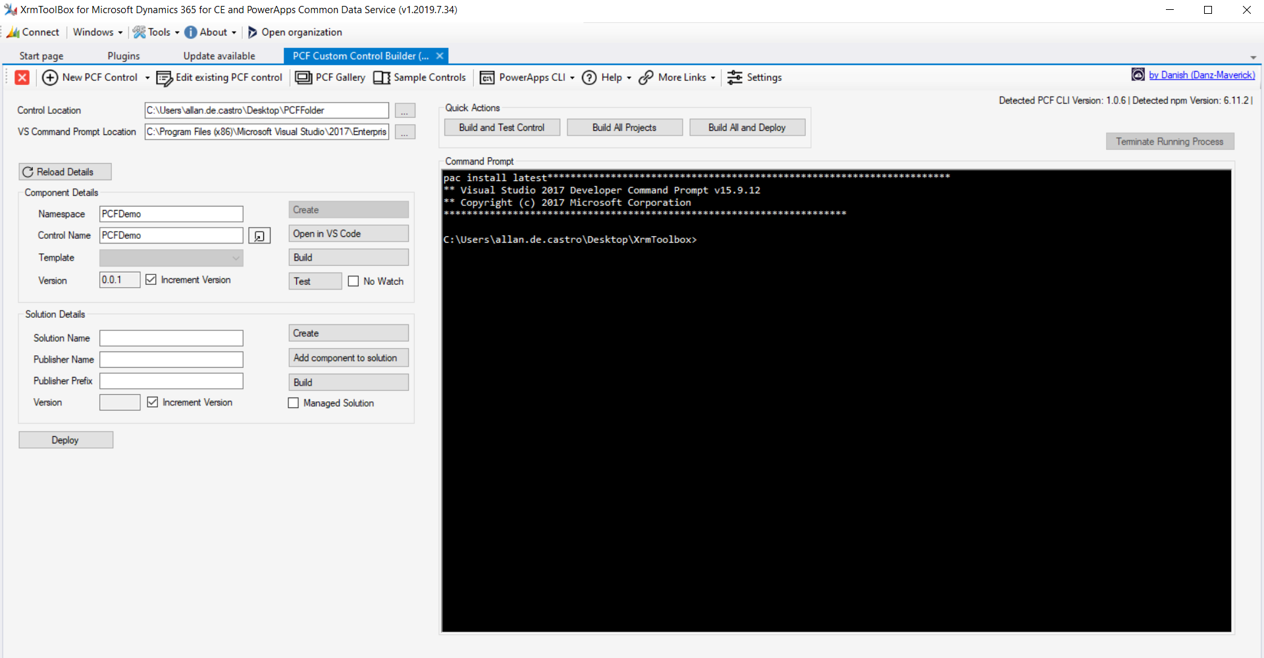
XrmToolBox Plugin by Danish
Facilitates the creation, building and deployment of custom PCF controls by eliminating the need to write commands.

Slide 28
What makes a custom component ?
Manifest Input File
Component Implementation
Resource Files
Control Definition:
Name
Version
Properties
Resource files
Code:
TypeScript / Javascript
User Interface
Functionality
Static Resources
CSS
Images
…
Notes:
The first thing to understand is that there are two different types of PCF projects:
Based on a field
Based on a data list
Depending on your choice, the properties of the component will therefore not be the same.
When generating a PowerApps Component Framework project, several elements will be automatically generated.

Slide 29
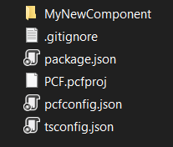
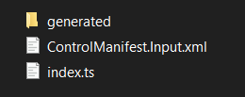
Creating a component
pac pcf init --namespace MyNewComponentNameSpace --name MyNewComponent --template field
Namespace for this component
Name of the component
Type of PCF project
Note: npm install to ensure to get required project dependencies.
Notes:
Here is the basic command to initialize a component, you define a namespace, a name and the tempalte to be used
It will generate a lot of file related to the project itself, and you see on the right the files that you will have to modify/to code

Slide 30
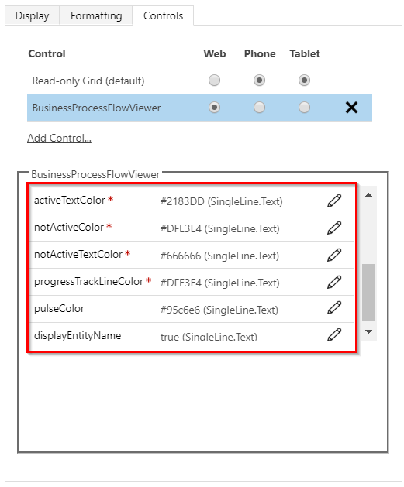
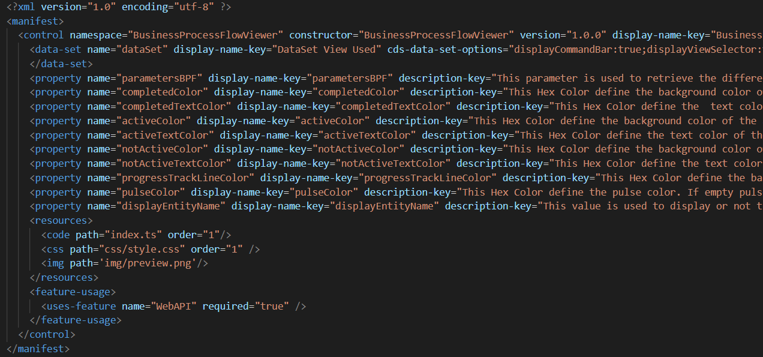
Managed properties & resources
Notes:
If we look at the manifest we'll see that this is where we'll specify which property this PCF has and also the different parameters that we'll set free to modify etc... As you can see here where we can change the colors

Slide 31
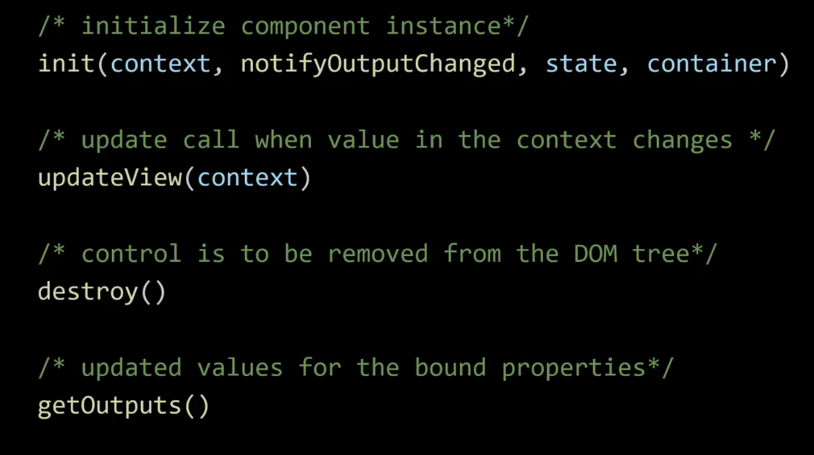
Life cycle of a component (index.ts)
Init: Initializes the control. Build the skeleton of its DOM and possibly call a logic to initialize what your component should do.
updateView: Called when the value of a property are changed (dataset refreshed..).
Destroy: Called when we decide to remove the component from the DOM.
getOutputs: Called when the output values are modified (usually the data is sent back to the application here, e.g a field that is modified).
Notes:
As I was saying we have to respect a certain architecture imposed by the framework so we have to make sure that the functions are automatically generated when we create our project:

Slide 32
Life cycle of a component
Constructor (empty)
Init
updateView
notifyOutputChanged
getOutputs
updateView
Notes:
Here is an example of how a component will be executed, the constructor is called when the form is built, then the INIT function that builds the PCF and finally the updateView function
When we want to tell the component that there is an update to do to the application we will callthe notifyOutpuchanged that will trigger the getOutputs function where we specified the values to return
Just a warning: If you have bound your component to the same field on which you decide to return a value, it will trigger again the updateview and so you will have a loop

Slide 33
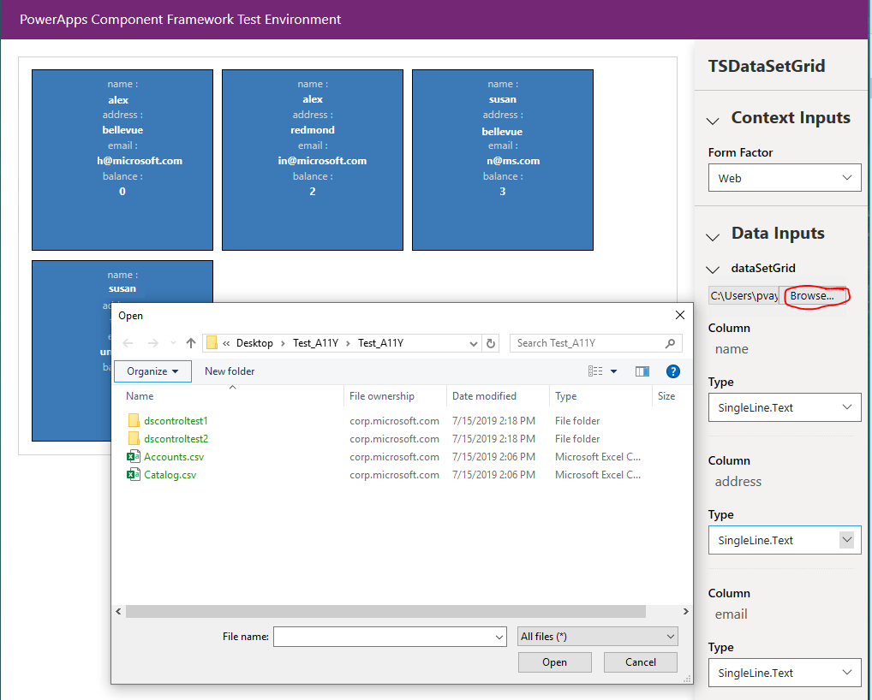
Build & Debug
npm run build
npm start watch (or you can use start npm start to open a new window)
Possibility to use fiddler: Debugging Canvas App Component
Notes:
Here are the basic commands used to build the component and also to test it locally which will allow you as you see it to use for example an excel file to simulate a grid/ dataset

Slide 34
Package a Component & Import the solution
Use CLI to create a solution (Managed/UnManaged) containing the custom control.
cd <solution folder>
pac solution init --publisher-name <enter your publisher name> --publisher-prefix <enter your publisher prefix>
pac solution add-reference --path <path of your Power Apps component framework project on disk>
msbuild /t:build /restore (msbuild must be in the path)
msbuild /t:build /restore /p:configuration=Release (If you want to build a managed package)
Import the solution into Dataverse Environement using the UI.
Notes:
Once the project has been created and finalized, we must create the solution that can be deployed in your environment.
To do this, we first create a folder and then initiate the project by specifying a publisher, etc...
We add the reference of our component
Then we build the component following the type of solution we want to use
Now all we have to do is install the solution!

Slide 35
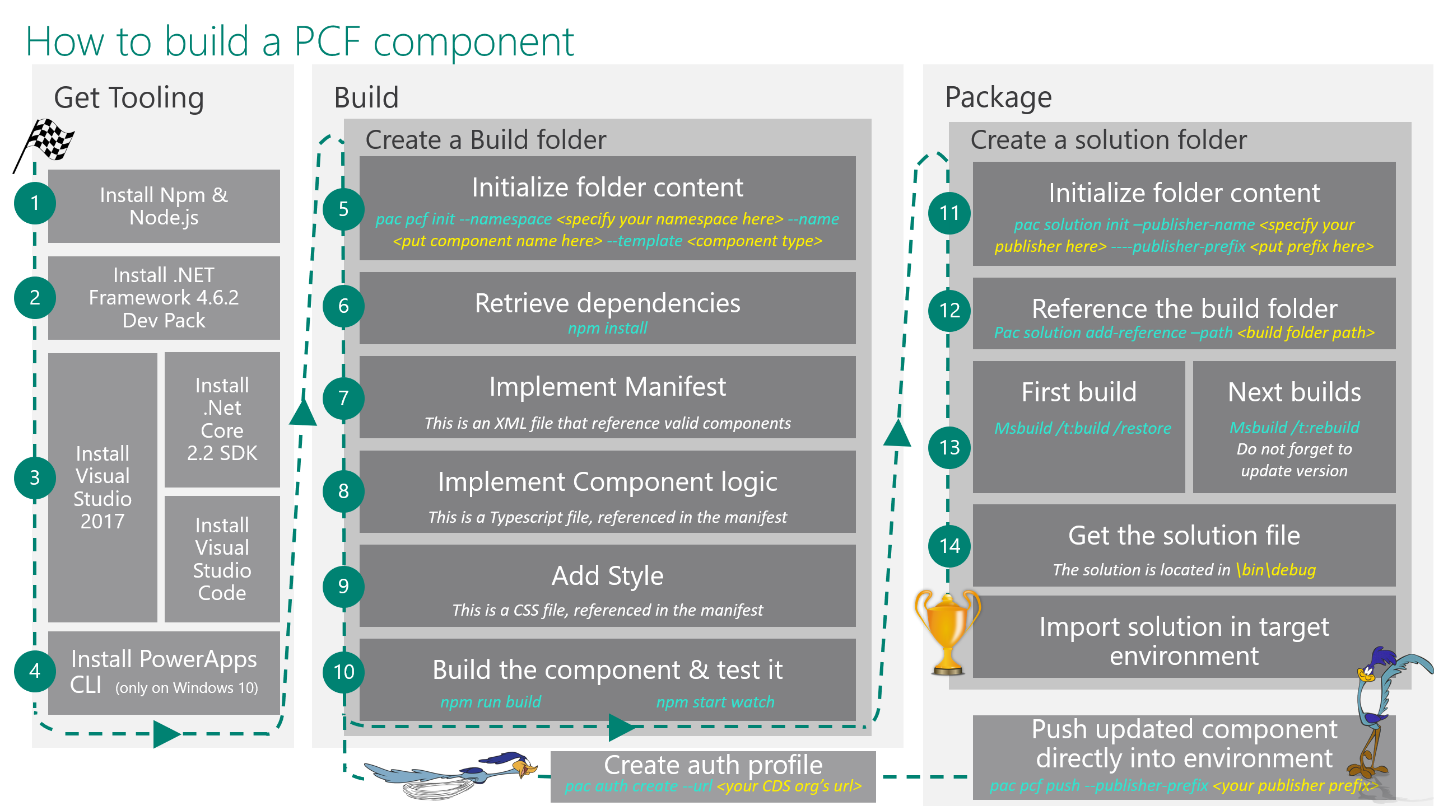
How to build a PCF Component
Credit : Nicolas Kirrmann
Notes:
Here is a recap as an image that will be available in my slides , so you can have an overview on how to build a PCF.

Slide 36
Links / References 1/2
PCF forum: https://aka.ms/PCFForum
Documentation: https://aka.ms/PCFDocs
Feature ideas: https://aka.ms/PCFIdea
Community components/blogs/demos: https://aka.ms/PCFDemos
Business App Summit 2019: Microsoft PowerApps: Building and Extending Applications
Ignite 2019: Using Power Apps component framework to build reusable custom user experiences. Ignite 2020 : Amplify your pro developer skills with Power Platform

Slide 37
Links / References 2/2
Implementing Security: http://develop1.net/public/post/2019/11/21/time-to-add-some-finishing-touches-to-your-pcf-controls Debugging PCF for Canvas App: http://develop1.net/public/post/2020/04/30/debugging-canvas-app-pcf-components-with-fiddler
Using CSS in PCF: https://benediktbergmann.eu/2020/01/04/pcf-css-for-model-driven-apps-mda/
Articles Series on my blog (https://blog.allandecastro.com):
Prelude: Getting started with PowerApps Component Framework
Episode 1: First Steps!
Episode 2: Focus on … Control Manifest file!
Episode 3: Focus on … Architecture & Component’s life cycle!
Episode 4 : Walkthrough to create your first PCF (based on a field)!

Slide 38
Thank You
#ScottishSummit2021

